Slide 1
Build Native Cross-Platform apps with .NET MAUI & Blazor Hybrid Workshop
Part 0 – Introduction

Slide 2
Agenda
Introduction to Blazor Hybrid
Building our First App
Displaying Data
Update Data & Use Components
Navigation
Accessing Platform Functionality
App Themes
Advanced Topics (Sharing State & Reusable Components)

Slide 3
Machine Setup

Slide 4
Code & Walkthrough
aka.ms/blazor-hybrid-workshop

Slide 5
What is Blazor?
Notes:
Then: what is Blazor? We all know single-page applications by now… <click>

Slide 6

https://...
Notes:
They run perfectly on the web with a rich experience, menu’s, all kinds of cool controls, dialogs and it’s all responsive too! So when you open it on a smaller device it will all scale nicely and the look and feel is automatically adapted to the device you’re running on. But if you think about those applications today… <click>

Slide 7



https://...
JS
Notes:
They are mostly written in Angular or React or Vue, all based on JavaScript. And while JavaScript definitely has it’s use, .NET developers typically don’t like writing it. And in any case, you will be much more efficient if you can just write in one language.

Slide 8


https://...
C# language
Tooling / IDE
Consistent ecosystem
Stability
Blazor
Notes:
Enter Blazor! With Blazor we gain a new single-page application framework that leverages the C# language, no JavaScript, unless you want to. There is still the possibility of JavaScript interoperability
You can use the tooling and IDE you know and love
It’s part of a consistent ecosystem, built right into ASP.NET, you can leverage all of the .NET ecosystem features, use NuGets, etc.
And because it’s built on top of all this proven technology, it has a very solid base and is very stable.

Slide 9



How it works
Blazor Server
Blazor WebAssembly
https...
https://...
ASP.NET Core
Razor Components
DOM
SignalR
DOM
.NET
Razor Components
WebAssembly
.NET

Slide 10



Modern web UI with .NET & Blazor
Server
WebAssembly
Hybrid

Slide 11
Full stack web UI with Blazor
Server
Server & Client
Client
Static server rendering
Enhanced navigation & form handling
Streaming rendering
Enable interactivity per component or page
Auto select the render mode at runtime

Slide 12
Blazor in .NET 8
Faster WebAssembly
New components
20% faster UI rendering
Display data with QuickGrid
Hot Reload improvements
Section outlets
Web-friendly packaging
Authentication & identity

Slide 13
Your Full Stack Web Platform with .NET
Web UI
APIs
Data
Server
Security
Tooling

Slide 14
Blazor Hybrid

Slide 15
What are hybrid apps and why build them?
Blend of native and web technology
Built using web tech (HTML, CSS, JavaScript) wrapped in a native app container
Access to native platform features and device hardware
Can mean mobile and/or desktop devices
Reach via app store distribution
Code reuse across device platforms and web browsers
Examples – Electron for desktop, Ionic for mobile
Notes:
Hybrid apps are a blend of both native and web solutions. The core UI of the application is written using web technologies such as HTML, CSS, and JavaScript. These apps are then wrapped in a lightweight native app "container" that allows them to leverage certain native platform features and device hardware (e.g., a device's camera, calendar, push notifications, and pinch and spread functionality) that a web application cannot access easily or even at all.
This approach allows hybrid apps to run on, for example, both iOS and Android platforms without the need for completely separate development. And they can be downloaded and installed through the app stores. The main advantage of hybrid apps is that they can achieve greater developer productivity via code reuse across devices and web browsers.
A couple examples are Electron for desktop apps and Ionic for mobile apps.

Slide 16
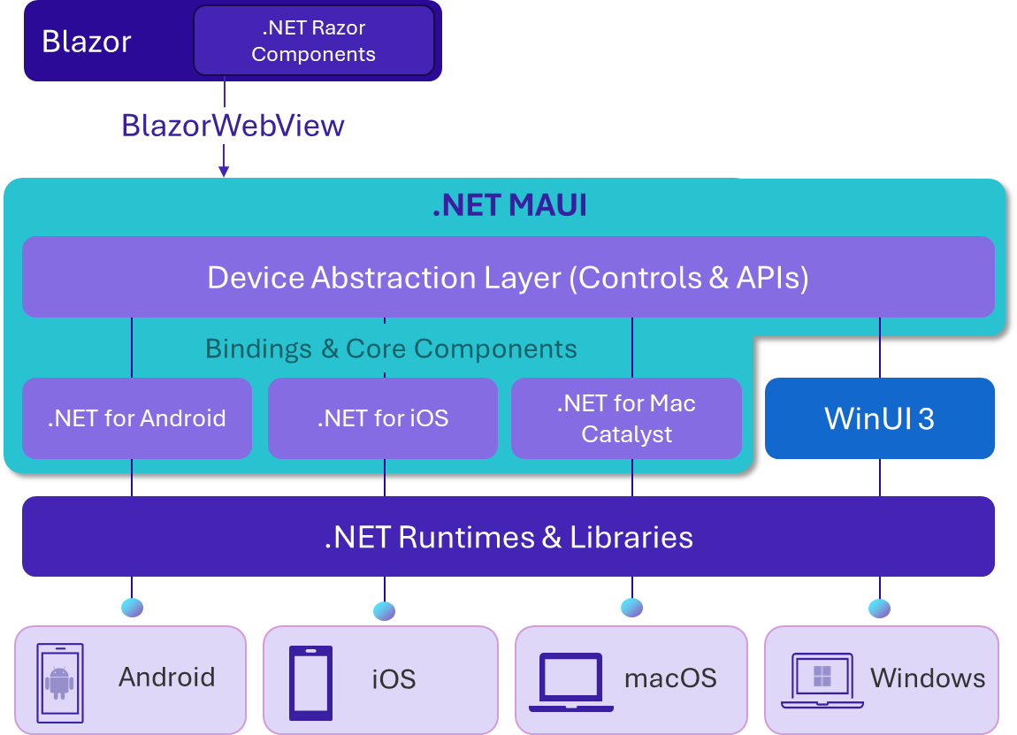
.NET MAUI Blazor Hybrid
Build native, multi-platform apps with Blazor web UI.
Native app container & embedded controls
Fully native web UI through platform WebView
No internet required, web assets packaged with app
Built-in Blazor input controls, validation, forms, auth
Ability to reuse web UI across native and web apps
Multi-platform with MAUI abstractions
App store distribution and reach
… + all the benefits of .NET MAUI & Blazor
Notes:
So what do we mean when we say .NET MAUI Blazor hybrid apps?
With .NET MAUI, Blazor apps can also run natively on devices. This means you can create hybrid client apps, which combine Blazor & MAUI components together into a single NATIVE client application, giving you full access to the native platform capabilities.
Blazor hybrid relies on .NET MAUI for a native application container and native controls, if you want to use them. So you could even mix Web UI with Native UI if you want.
Blazor hybrid apps are built on top of .NET MAUI. You host Blazor components with the BlazorWebview control with derives from the native platform’s WebView. No internet is required, UI is packaged with the app. And you can use all the built-in input controls, validation, forms, and auth flows that Blazor provides right out of the box. This makes it easier to share UI across native and web hosting models.
Blazor hybrid apps have full access to the MAUI abstractions and the native devices. This makes it easy to do native things that can be difficult or impossible on the web alone. You can do things like call native API's, access the file system, make phone calls, format the c: drive! Don’t do that, but you get my point!
It also gives you the ability to take your apps and package them for store distribution and reach whether that’s the Windows, Apple or Google App stores.

Slide 17
Reusing UI across native and web
Web
Native
Blazor web app
MyApp.Web
MAUI hybrid app
MyApp.MAUI
Shared UI & Interfaces
Razor class library
MyApp.Shared
.NET
Razor Components
Notes:
One of the biggest benefits of hybrid apps is being able to reuse your UI across your native and web apps. In .NET, if you also want to target web browsers, you can structure your solution to maximize code reuse using a shared Razor Class Library that houses the shared UI as well as interfaces for the functionality you want to use from the UI. The implementations of these are then defined in the specific Blazor Web and MAUI projects. This is because sometimes you need to write different code for the different hosting models. This gives you a clean way to do that.

Slide 18



.NET offers choice for client app developers
.NET MAUI
.NET MAUI + BLAZOR
BLAZOR
C#, XAML
C#, HTML, CSS
Depth
Reach
Native apps
Hybrid
Websites and PWAs
Notes:
If we zero in on modern client development for .NET, we also have choices. The route you take depends on whether you want the most reach or the deepest native experiences.
<CLICK>
For reach we have the web and there’s Blazor. Blazor lets you build, fast, interactive web apps quickly with C#.
<CLICK>
Then there’s .NET MAUI which lets you build cross-platform native desktop and mobile apps with a single codebase.
But it’s a sliding scale.
<CLICK>
We can use the best of Blazor and the best of MAUI together. Depending on your application’s needs, you can choose the right mix for you. Fully web for the most reach, fully native for the richest native experiences, or a little bit of both with hybrid.

Slide 19
Q&A
Any questions so far?

Slide 20
Part 0 – Introduction
https://aka.ms/blazor-hybrid-workshop
Notes:
That’s it for Part 0, lets head over to this URL, get all the code and start building!

